Slide 1
A System for Automated Vehicle Damage Localization and Severity Estimation Using Deep Learning

Slide 2
ABSTRACT
This project presents an advanced system for Automated Vehicle Damage Localization and Severity Estimation using deep learning, developed to automate the traditionally manual process of assessing vehicle damage. Built using Python for the backend and HTML, CSS, and JavaScript for the frontend, the system operates on the Flask web framework, offering a user-friendly, web-based interface. At the core of this system is the YoloV8 model, a state-of-the-art object detection algorithm capable of identifying and categorizing vehicle damage with high precision. The system achieves an accuracy of 91%, making it an effective solution for tasks like insurance claims processing, vehicle repair evaluation, and accident analysis.

Slide 3
The system supports three modes of operation: image-based, video-based, and webcam-based predictions, making it versatile for various practical applications. In the image-based mode, users upload images of vehicles, and the model analyzes the image to detect, localize, and classify different types of damage. The video-based mode extends this capability to moving images, enabling real-time damage detection in videos. Finally, the webcam-based mode provides a live stream for instant damage detection, making the system adaptable to dynamic environments like car repair shops or roadside assistance services.

Slide 4
The dataset used for training and validation comprises 778 labeled images, with 485 images for training and 293 for validation. The dataset includes eight specific damage categories: damaged door, damaged window, damaged headlight, damaged mirror, dent, damaged hood, damaged bumper, and damaged windshield. By detecting and localizing these damages, the system can accurately estimate the severity and nature of the vehicle’s condition, streamlining workflows for professionals in the automotive and insurance sectors.

Slide 5
This automated system represents a significant technological leap in vehicle damage assessment. Its ability to accurately detect and classify vehicle damages in real-time minimizes human error, speeds up processing, and improves the overall reliability of damage assessments. The flexibility provided by the three different prediction modes—image, video, and webcam—ensures that the system can be applied in a wide range of scenarios, from individual use to professional environments, offering valuable efficiency and accuracy in vehicle damage evaluation.

Slide 6
EXISTING SYSTEM
The existing system introduced a structured framework using computer vision to address the challenge of vehicle damage localization and severity estimation. It marked the first attempt to integrate multiple deep learning modules into a human-in-the-loop approach for automating the process of damage assessment. The system was specifically designed to analyze user-acquired photographs of vehicles, streamlining the identification of damaged areas and providing an estimation of the damage severity.
The existing system experimented with several convolutional neural network models. Specifically, explored various architectures including VGG16, VGG19, ResNet50, InceptionResNetv2, Inceptionv3, MobileNet and MobileNetv2. The best vehicle presence classification model was a MobileNet.

Slide 7
In the existing system, by leveraging both corporate-owned OE Insured Fleet data and user-acquired OEM data, the system demonstrated its effectiveness across varied datasets. This comprehensive approach highlighted the potential of using deep learning for vehicle damage assessment, allowing for more accurate and reliable results. The evaluation of results on diverse datasets underscored the system's versatility and potential to enhance automation in the damage assessment process.

Slide 8
In terms of classification, the existing system focused on four primary damage categories: No damage, Body Damage, Surface Damage, and Deformity. It employed deep learning techniques to systematically detect and classify these damage types from images. However, the system was limited to image-based detection only, providing a foundational yet crucial step toward building an automated damage localization and severity estimation platform for the automotive and insurance sectors.

Slide 9
DISADVANTAGES OF EXISTING SYSTEM
The existing system that utilized MobileNet for vehicle damage localization and severity estimation, while effective in certain aspects, had several notable disadvantages that impacted its overall performance and scalability. One of the primary limitations of MobileNet was its focus on lightweight architecture, which, although advantageous for mobile and low-resource environments, often resulted in lower accuracy compared to more advanced deep learning models. In the context of vehicle damage detection, this reduced precision could lead to misclassification or incomplete identification of damages, especially in cases of complex or subtle damage patterns.

Slide 10
Another drawback was MobileNet's limited capacity to handle large-scale, high-resolution images, which are crucial for accurate vehicle damage detection. Vehicle damage, especially small dents or surface-level damage, requires high-resolution analysis to be detected effectively. MobileNet's design prioritizes speed and efficiency over detail, which can result in a trade-off where important damage features may be missed, affecting the reliability of the system for detailed assessments.
Moreover, the system was constrained to image-based detection only, limiting its flexibility in handling other types of inputs like video streams or real-time webcam feeds. This restriction reduced the system's applicability in dynamic environments, such as real-time vehicle inspections or live damage assessments, where more robust detection models are needed.

Slide 11
Lastly, the system’s damage classification was limited to broad categories, and MobileNet's simplified architecture struggled with fine-grained classification tasks, such as distinguishing between specific types of damage (e.g., broken headlights, damaged mirrors, or windshield cracks). This lack of granularity hindered the system's ability to provide detailed assessments, which are essential for accurate repair cost estimation and insurance claims processing.
In summary, while MobileNet offered a lightweight solution, its compromises in accuracy, resolution handling, and limited input flexibility made it less suitable for comprehensive vehicle damage localization and severity estimation tasks.

Slide 12
PROPOSED SYSTEM
The proposed system introduces a more advanced and comprehensive approach to vehicle damage localization and severity estimation by utilizing the YoloV8 model. Unlike its predecessor, this system is designed to handle multiple modes of operation, including image-based, video-based, and webcam-based predictions, offering greater flexibility for various real-world applications. The integration of these multiple input types allows the system to analyze both static and dynamic data, making it suitable for real-time assessments as well as post-incident evaluations.

Slide 13
The proposed system is developed using Python as the backend and HTML, CSS, and JavaScript for the frontend, with the Flask web framework providing the necessary infrastructure for a user-friendly and responsive interface. By implementing YoloV8, a powerful object detection algorithm, the system is capable of precisely detecting, localizing, and classifying specific types of vehicle damage with high accuracy. The dataset used for training and validation includes 778 images, which are categorized into eight detailed classifications: damaged door, damaged window, damaged headlight, damaged mirror, dent, damaged hood, damaged bumper, and damaged windshield. This finer level of classification allows the system to identify and differentiate between various types of damage in a more detailed manner.

Slide 14
The proposed system is designed to work efficiently across different environments, whether through analyzing uploaded images, processing video footage, or conducting live assessments via a webcam. By utilizing YoloV8 for object detection, the system is capable of providing accurate localization of vehicle damages, improving the precision of damage severity estimations. This approach enhances the system’s capability to manage diverse scenarios, from insurance claim processing to automotive repair assessments, while offering a more structured and detailed framework for damage evaluation.

Slide 15
ADVANTAGES OF PROPOSED SYSTEM
The proposed system offers several key advantages that enhance its effectiveness and usability in vehicle damage localization and severity estimation. One of the primary benefits is the use of the YoloV8 model, which provides high accuracy in detecting and classifying vehicle damage. With an impressive 91% accuracy, the system is capable of identifying even subtle damages with precision, ensuring a more reliable assessment compared to earlier approaches. The fine-grained classification of damages, covering eight specific categories like damaged doors, windows, headlights, mirrors, dents, hoods, bumpers, and windshields, allows for a more detailed and accurate analysis of the vehicle’s condition.

Slide 16
A significant advantage of the system is its support for multiple input modes, including image-based, video-based, and webcam-based detection. This flexibility enables the system to be used in a variety of real-world scenarios. For example, image-based detection is suitable for post-incident evaluations, while video-based and webcam-based predictions allow for real-time, dynamic assessments during vehicle inspections or roadside evaluations. This versatility makes the system applicable to a broader range of environments, from insurance companies to vehicle repair shops.
Furthermore, the integration of a web-based interface developed with HTML, CSS, JavaScript, and Flask ensures that the system is easy to use and accessible from various devices. Users can interact with the system via a browser, upload images, or stream videos, making it convenient for both individuals and professionals. The streamlined interface, combined with the backend power of YoloV8, allows for efficient processing and faster damage detection.

Slide 17
The scalability of the system is another advantage. It can process and analyze large datasets, which makes it adaptable to growing demands, whether for corporate fleets, insurance assessments, or general consumer use. By automating much of the damage detection and severity estimation process, the system reduces the need for manual inspections, improving speed, efficiency, and consistency in assessments. This automation also minimizes human error, ensuring that damage is localized and classified accurately every time.

Slide 18
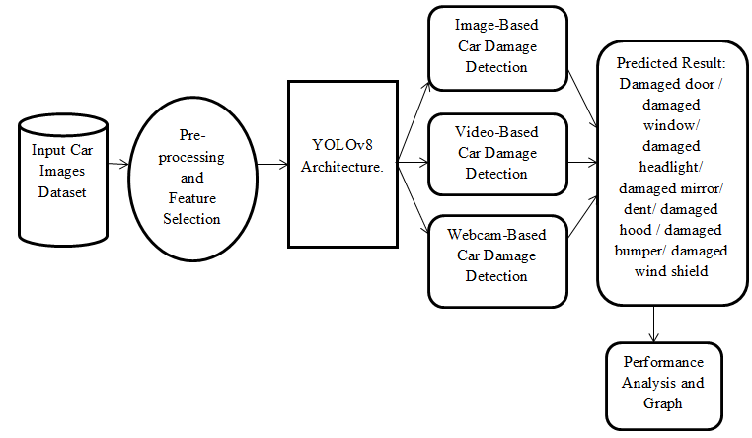
SYSTEM ARCHITECTURE

Slide 19
HARDWARE REQUIREMENTS
System : Pentium i3 Processor.
Hard Disk : 500 GB.
Monitor : 15’’ LED
Input Devices : Keyboard, Mouse
Ram : 4 GB

Slide 20
SOFTWARE REQUIREMENTS
Operating System : Windows 10 / 11.
Coding Language : Python.
Web Framework : Flask.
Frontend : HTML, CSS, JavaScript.

Slide 21
REFERENCE
Yuntao Ma , Hiva Ghanbari, Tianyuan Huang, Jeremy Irvin, Oliver Brady, Sofian Zalouk, Hao Sheng, Andrew Ng, Ram Rajagopal , Member, IEEE, and Mayur Narsude, “A System for Automated Vehicle Damage Localization and Severity Estimation Using Deep Learning”, IEEE TRANSACTIONS ON INTELLIGENT TRANSPORTATION SYSTEMS, VOL. 25, NO. 6, JUNE 2024.

